Slide 1

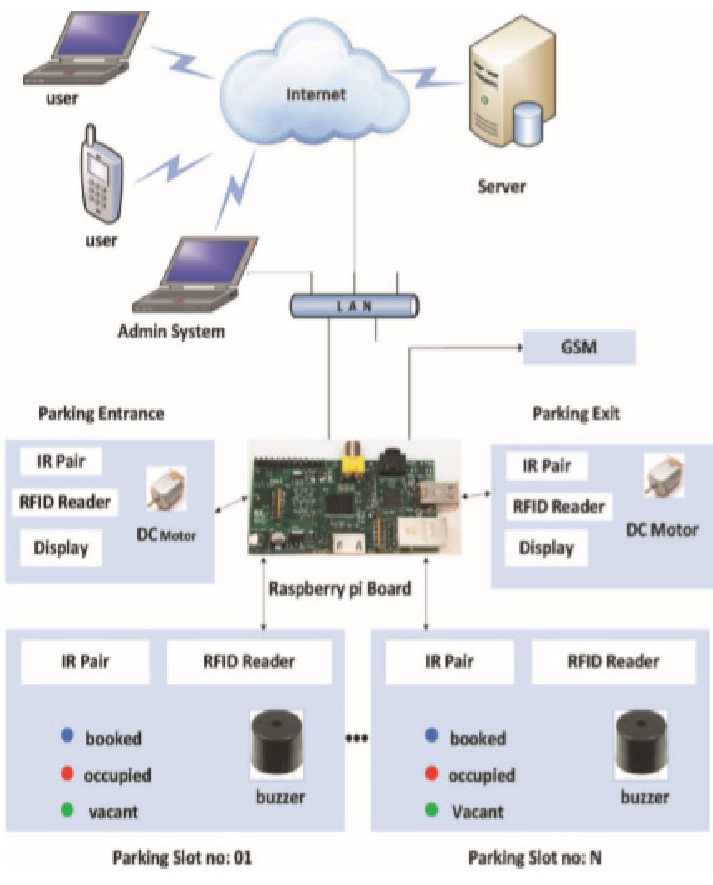
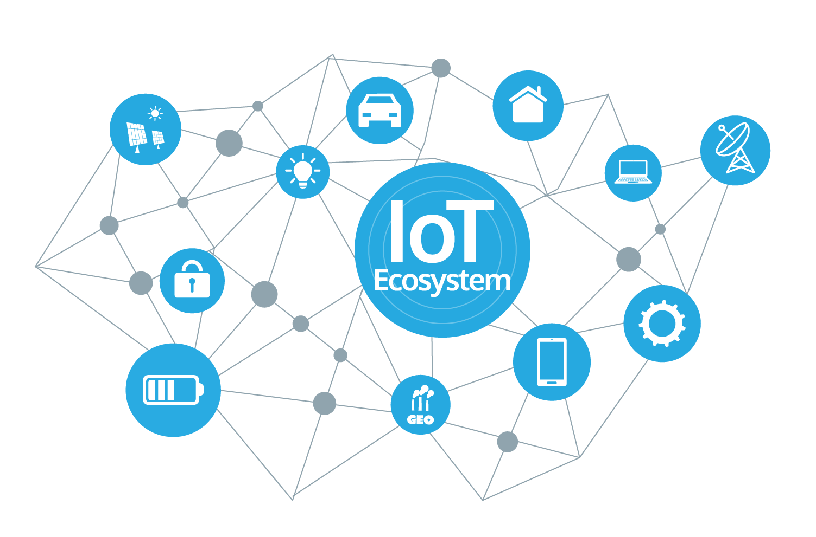
Constructive investigation with Internet of Things (IoT): Case of Smart Parking
M.M. Nkosi, P. Tarwireyi
Dept. of Computer Science, University of Zululand
Introduction
Proposed Research
Related Work
With high rise of car ownership, finding a parking lot in metropolitan areas has become a conflict and frustrating situation for most car owners.
This means that time will be wasted on trying to find a parking lot, high increase in unnecessary car accidents, and money wastage.
There is not enough information for motorists [1].
This work explores the use of IoT for smart parking system.
In [3], authors present the use of machine to machine (M2M) communication between devices which collects a lot of useful data without any human intervention. This data will be analyzed to make better decisions. All the applications of this technology culminate in increased comfort, convenience, and better management, thereby improve the quality of life.
Authors in, [4] proposed a simple solution by applying Class Client Geocoder in Google Maps API. A Client Geocoder object communicates with Google map servers to obtain geocodes for user-specified addresses. A Geocoder object maintains its own cache of addresses, which allows repeated queries to be answered without a round trip to the server.
The external feature displayed in [5] shows that Google Maps Direction API which retrieves the duration and distance values for multiple destinations and transport modes.
Figure 2. Proposed System architecture.
Figure 1. Internet of Things(IoT) [2].
The proposed architecture uses Arduino boards, HC-SR04 sensors, NodeMCU, android app, and Firebase.
The application will give user current location in terms of distance and travel time [4].
Guide vehicle to the nearby parking slot using shortest possible paths [5].
Reserve parking slot for the user and display time to reach the spot.
Exceeding the time limit let the user know that the booking was cancelled and prompt to make another request.
Store user's subscription history
Store frequently used parking slot under the tab called “Premium User” [6].
Aim and Objectives
References
The goal is to implement a smart parking system that will alleviate the problems facing vehicle owners. Objectives of the study are (Hardware ) [3]:
Read data from the sensors
Save data on database
Check condition of all parking slots
Generate a random password
Match input of password to open gate in front of parking (entrance).
Smart City: IoT Based Prototype for Parking Monitoring and Management System Commanded by Mobile App. Available: https://www.research.net/publication/317495359_Smart_City_IoT_Based_Prototype_for_Parking_Monitoring_and_Management_System_Commanded _by_Mobile_App/.
Gandhi BMK, Kameswara RM. A Prototype for IoT based Car Parking Management System for Smart Cities. Indian Journal of Science and Technology. 2016; 9(17):1-6.
Thanh Nam Pham, Ming-Fong Tsai, Duc Binh Nguyen, Chyi-Ren Dow, Der-Jiunn Deng, “A cloud based Smart-Parking System based on Internet of Things Technologies”, IEEE Access, Special Section on Emerging Cloud-based Wireless Communication and Networks, Vd. 3, September 2015.
Bhavthankar S, Sayyed HG. Wireless framework for Vehicle Accident Detection using Accelerometer sensor and Reporting with the help of GPS. International Journal of Scientific & Engineering Research. 2015;6(8):1-4.
Zhanlin Ji, Ivan Ganchev, Mairtin O Droma, Li Zhao, Xueji Zhang, “A Cloud-Based Car Parking Middleware for IoT-Based Smart Cities: Design and Implementation”, Sensors 2014, 14, 22372-22393; doi:10.3390/s1222372, ISSN 1424-8220, November 2014.

